Slide 1
Introduction to Deep Learning
Saneem Chemmengath
IBM Research AI

Slide 2
Training an ML model

Slide 3


Outline of training procedure
Model
Learning Algorithm
.
.
Training set

Slide 4
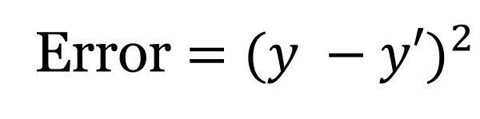
Regression
y'
y = w₁x₁ +w₂x₂ +w₃x₄
w₁
w₂
w_{n}
x₁
x₂
x₃
Update w in such a way that the error is minimized !

Slide 5
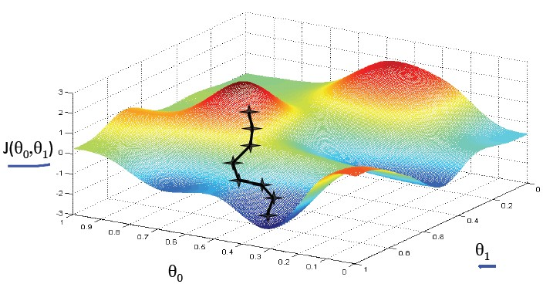
Gradient Descent Algorithm

Slide 6
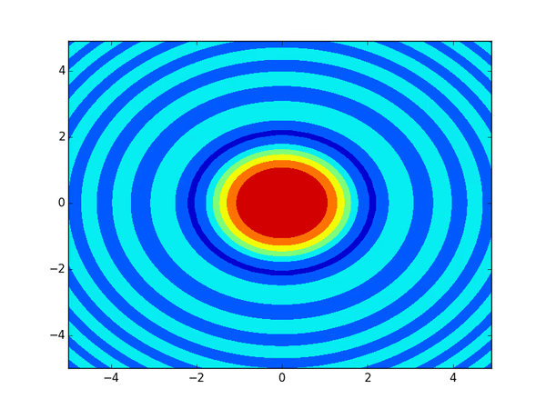
Gradient Descent Algorithm

Slide 7
Deep Learning and AI boom

Slide 8
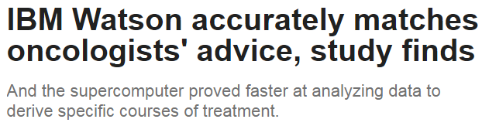
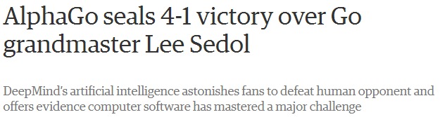
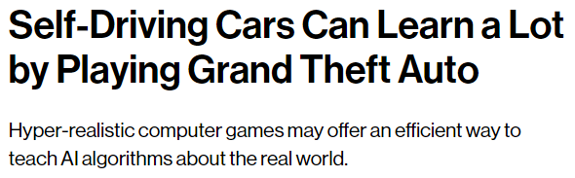
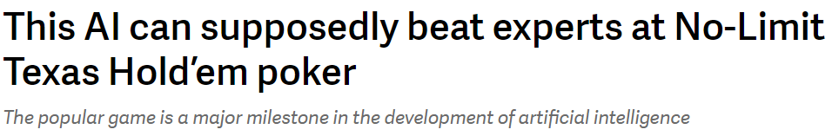
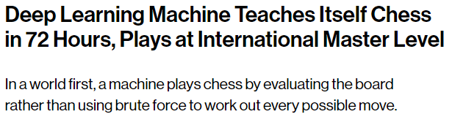
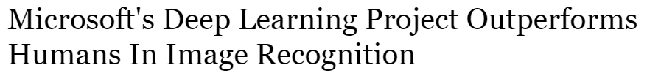
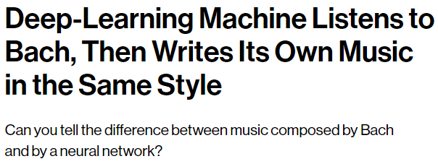

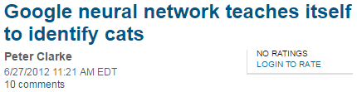
Deep Learning everywhere!!

Slide 9
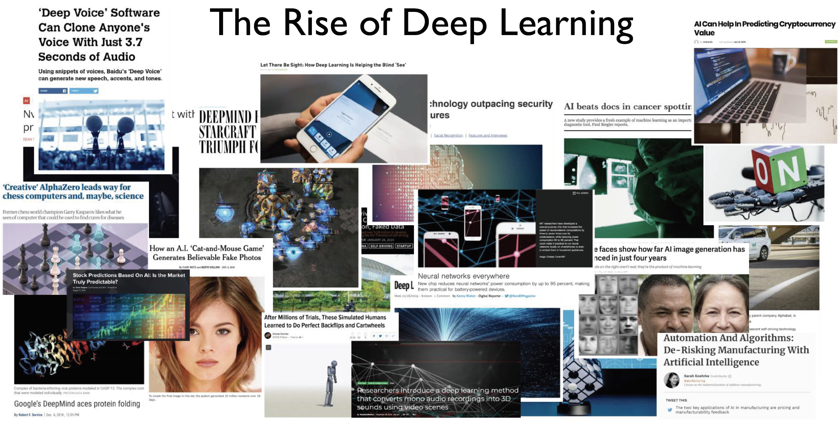
Deep Learning everywhere!!

Slide 10
What is Deep Learning?

Slide 11
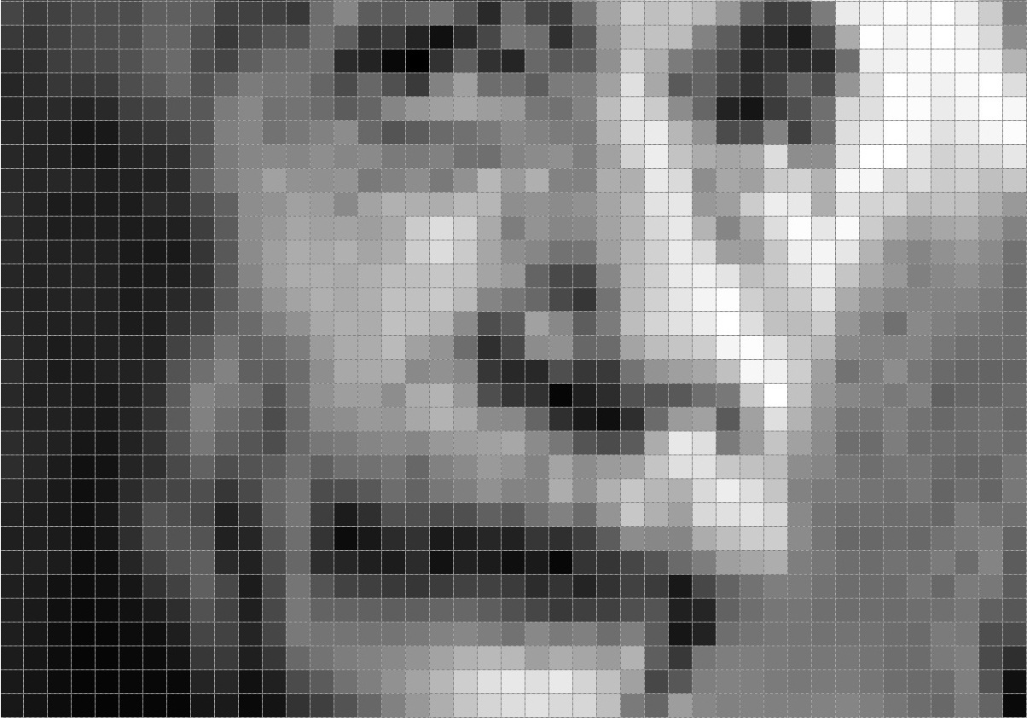
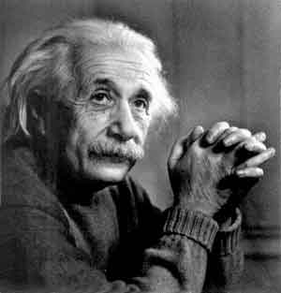
What is feature extraction?

Slide 12
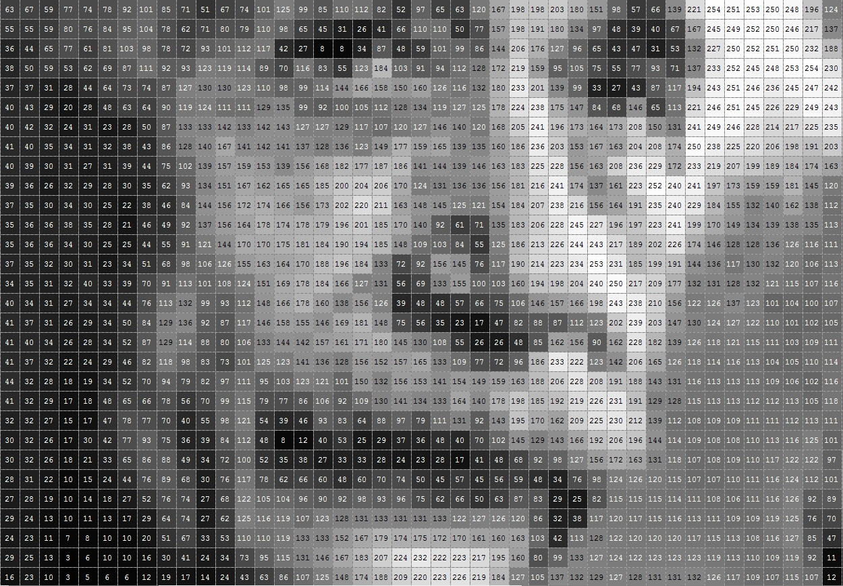

Slide 13
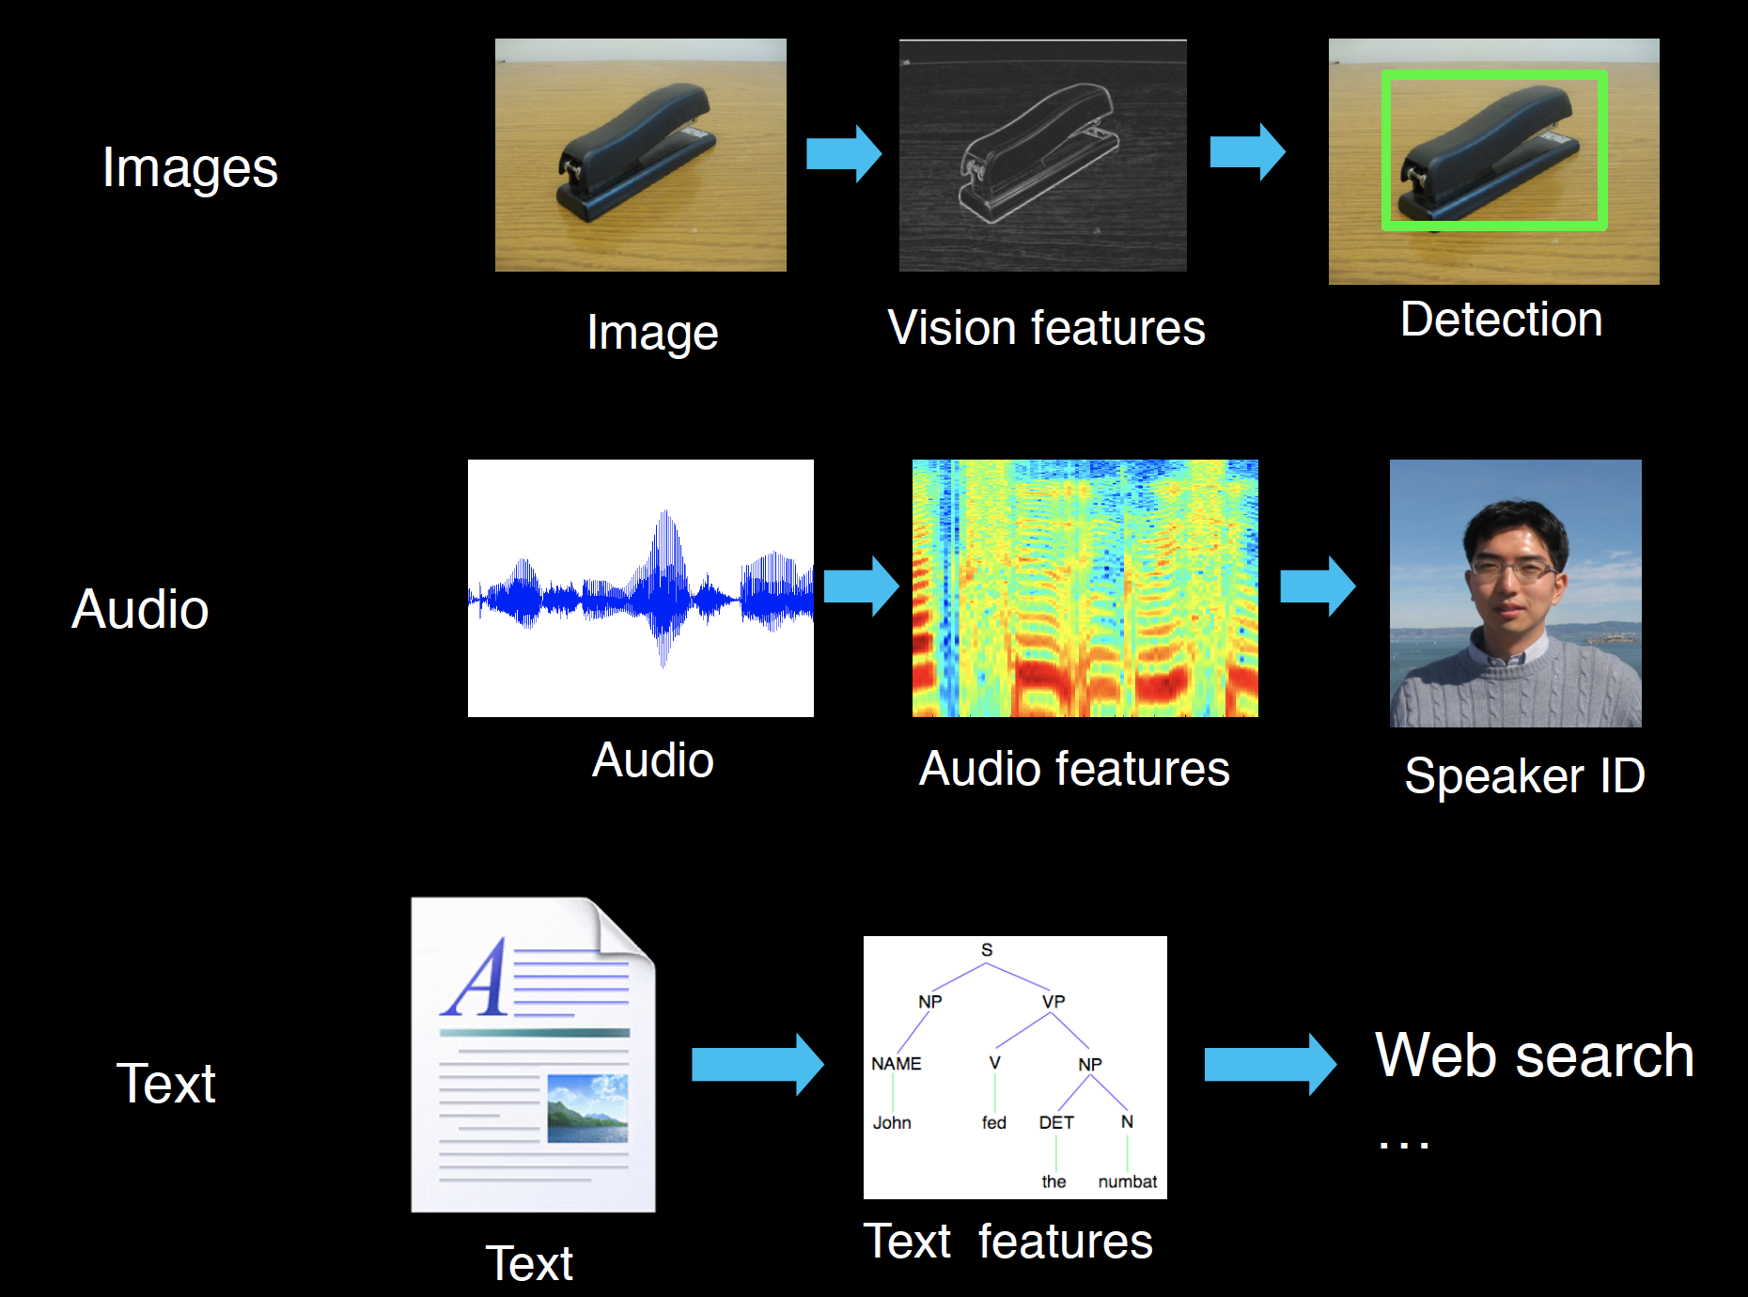
Feature extraction for machine learning

Slide 14
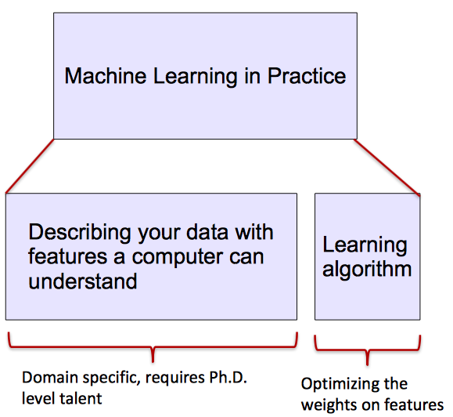

Data analysis pipeline
Gather Data
Extract Features
Learn
Predict
Extract Features: conversion of raw data into some useful format

Slide 15

Deep Learning: Automate feature extraction
A machine learning subfield of learning representations of data. Exceptional effective at learning patterns.
Deep learning algorithms attempt to learn (multiple levels of) representation
Manually designed features are often over-specified, incomplete and take a long time to design and validate

Slide 16

Simple neural network

Slide 17
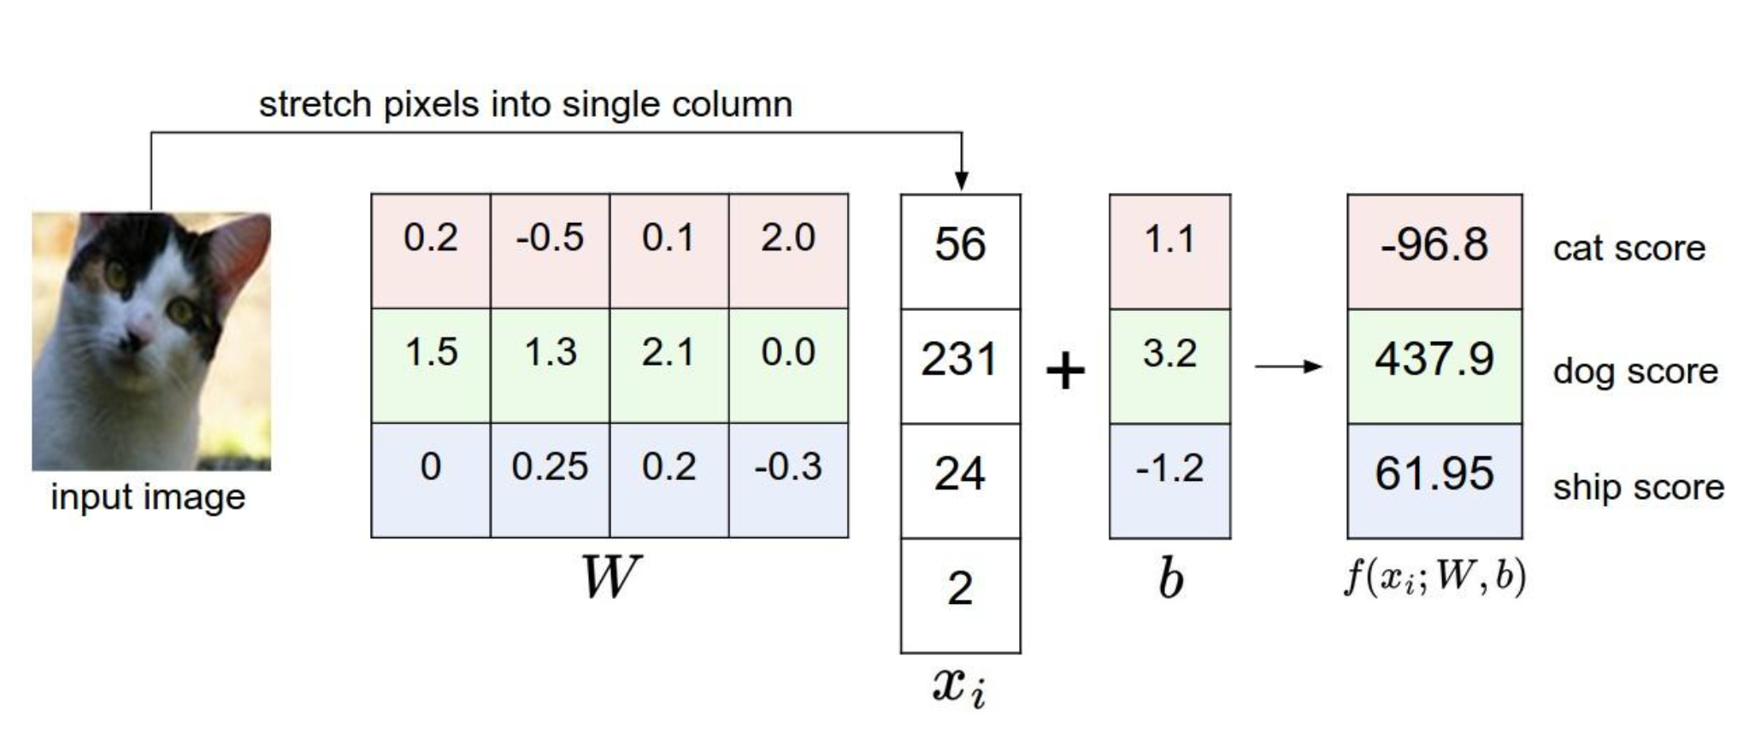
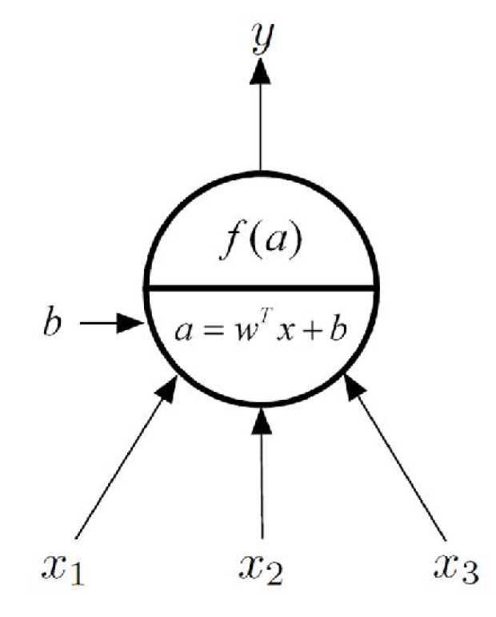
One layer neural network

Slide 18
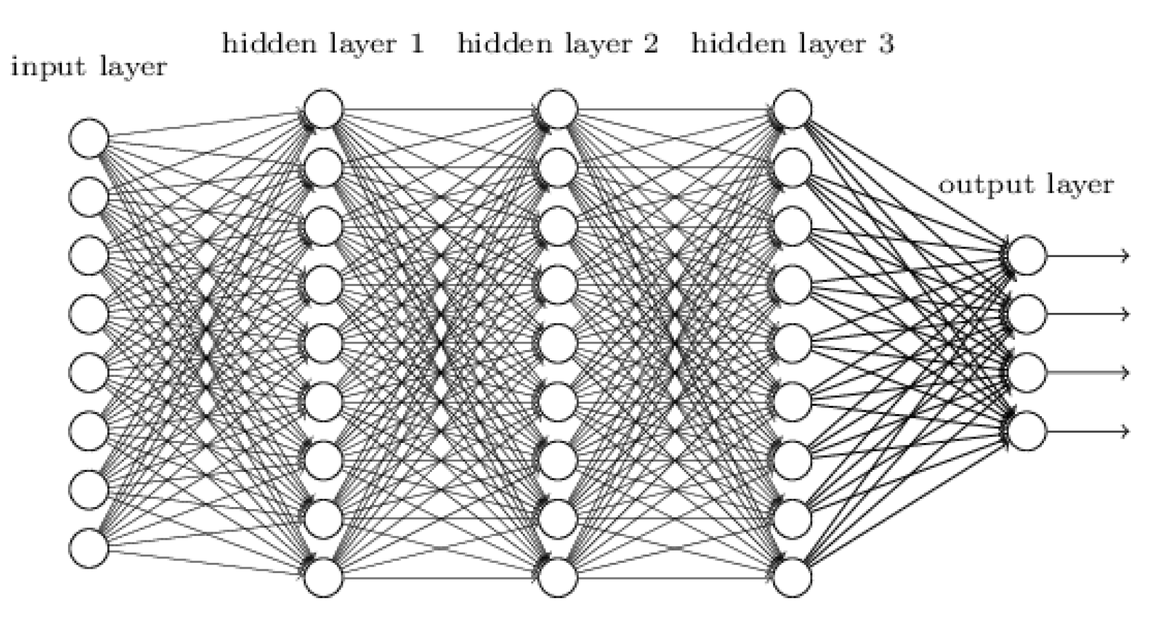





Multiple layer neural network

Slide 19
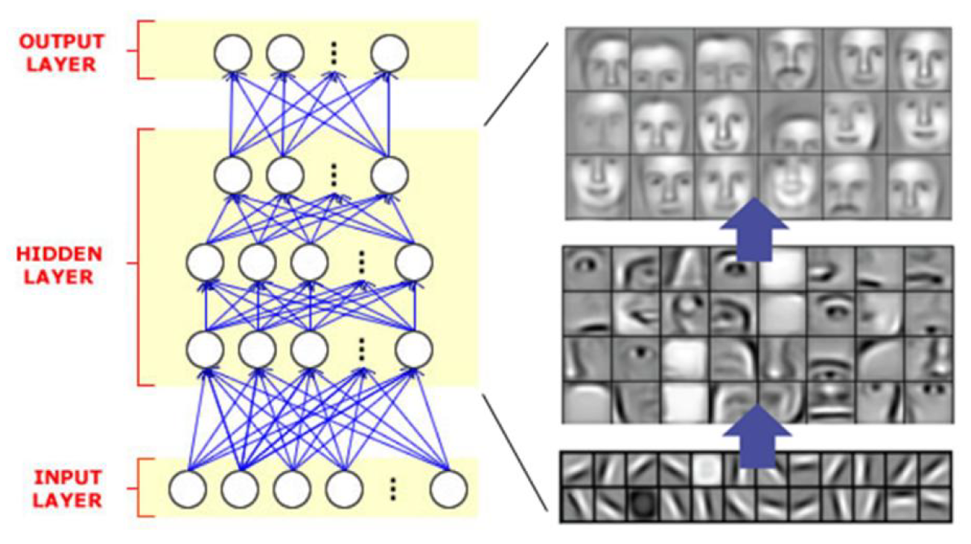
What is being captured in each layer?

Slide 20
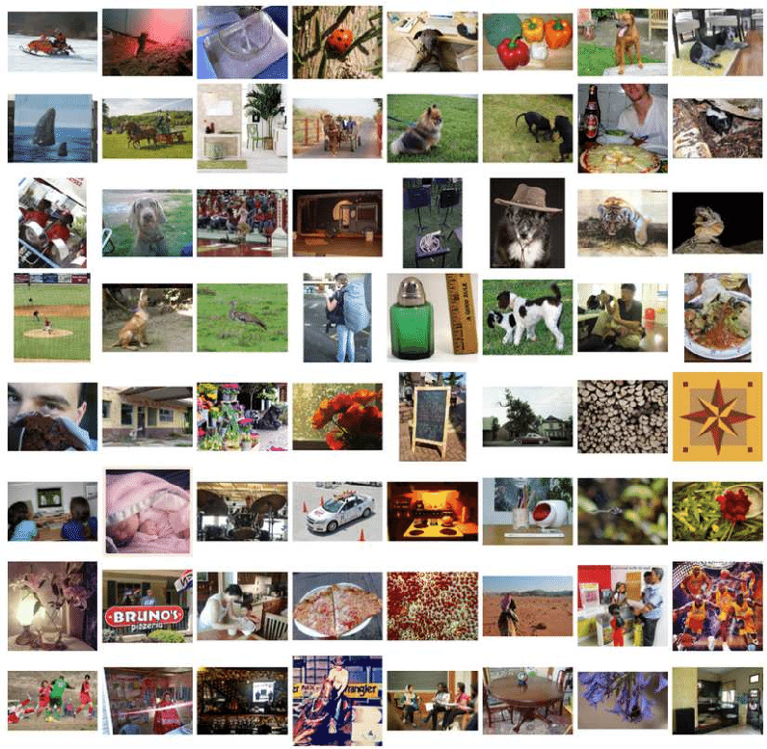
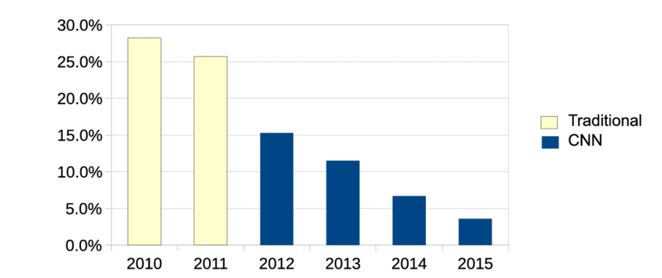
ImageNet challenge
Image classification challenge
1.2 million images in 1000 classes.
Error rate

Slide 21
Fancy Deep Learning Applications

Slide 22
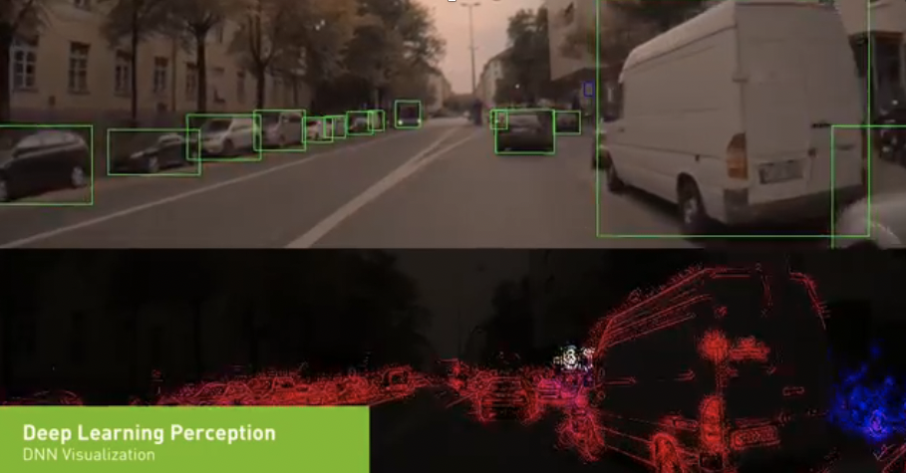
Beyond classification and regression

Slide 23
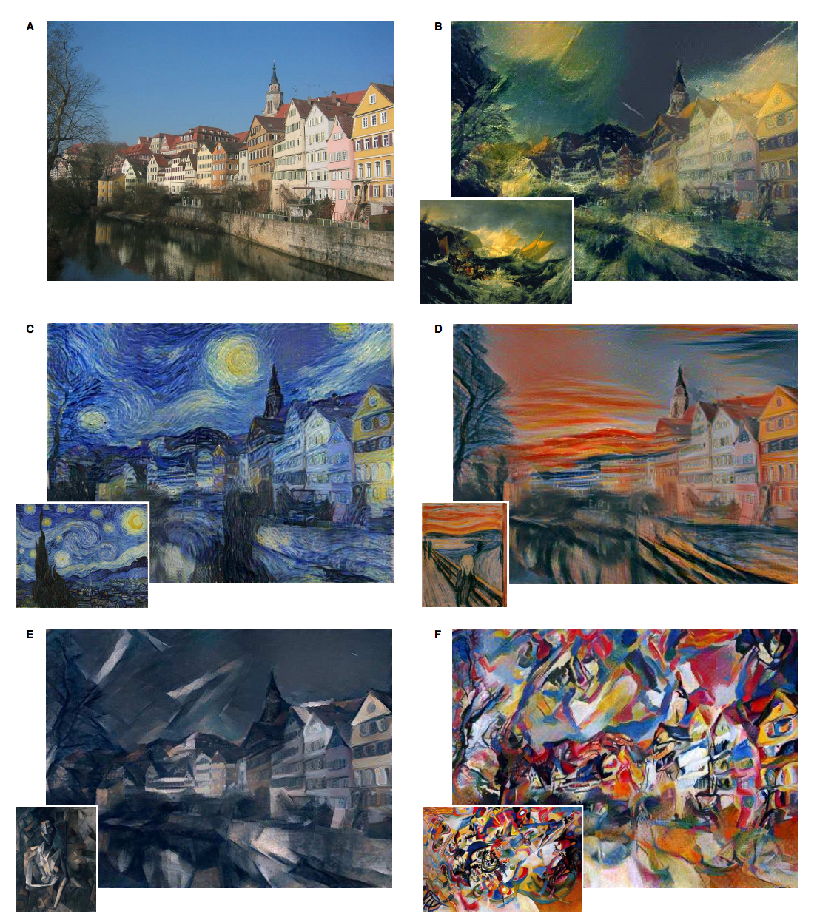
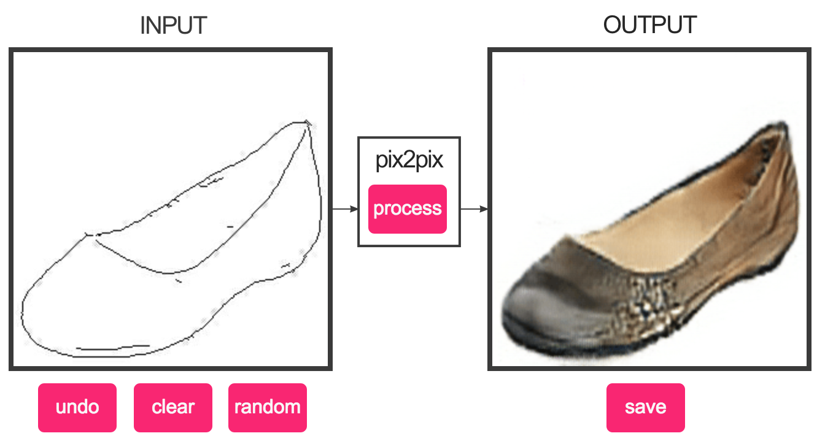
Output could be images

Slide 24
Questions?

